Slide 1


DESIGN CREDIT PROJECT
SOFT SENSOR WWTP
By-
Harsh Raj (B21CH008)
Jahnavi Pandey (B21CH010)
Kachhawa Goutham(B21CH011)

Slide 2

TABLE OF CONTENT
Objective and Aim
Motivation Behind the project
Approach
Results
Conclusion

Slide 3
OBJECTIVE
To develop predictive models for accurately estimating fluoride concentrations in the effluent of an urban water treatment plant (WTP). Using machine learning techniques like Linear Regression, Decision Tree, and Random Forest, the project seeks to determine the most effective model for guiding decision-making processes.
SPECIFIC AIMS
Evaluate and compare the performance of several predictive models on the dataset.
Identify key factors that significantly impact the predicted outcomes.
Optimize model parameters to enhance prediction accuracy.

Slide 4


MOTIVATION BEHIND THE PROJECT
Improving WTP Operational Efficiency: Utilizing predictive models to forecast fluoride levels can help optimize treatment processes, reducing the need for excessive chemical use and minimizing treatment costs.
Innovative Approach in Soft Sensor Technology: By applying machine learning techniques, specifically a multi-layer perceptron neural network, the research explores innovative methods in soft sensor technology, contributing to the field of environmental engineering.
Reducing Dependency on Lab Measurements: Developing a model that reduces the reliance on frequent laboratory measurements, which are costly and time-consuming, by providing real-time monitoring capabilities.
Cost Efficiency: Implementing predictive models could significantly reduce operational costs by minimizing the need for physical and chemical tests, which often require expensive equipment and reagents.

Slide 5

APPROACH
Data Collection
Model Selection
Gathered water quality data including chlorine, turbidity, pH, color, and fluoride levels.
Implemented various machine learning models including: Linear Regression, Random Forest, Decision Tree, Neural Networks (NN), Recurrent Neural Networks (RNN),Long Short-Term Memory (LSTM) networks.
Data Preprocessing
Cleaned and preprocessed the data to address issues with missing values .

Slide 6
APPROACH
Model Training and Evaluation
Model Comparison
Each model was trained on the dataset and their performance was evaluated using Mean Squared Error, Root Mean Squared Error and Mean Absolute Error:
Compared the performance of the different models to determine the most accurate and reliable model for predicting water quality.

Slide 7
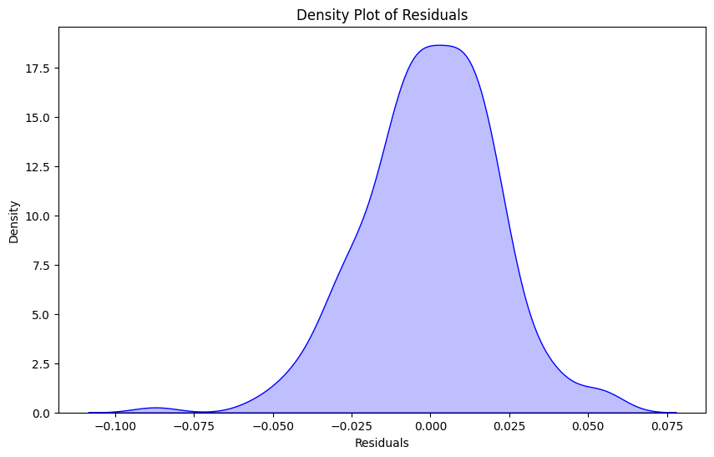
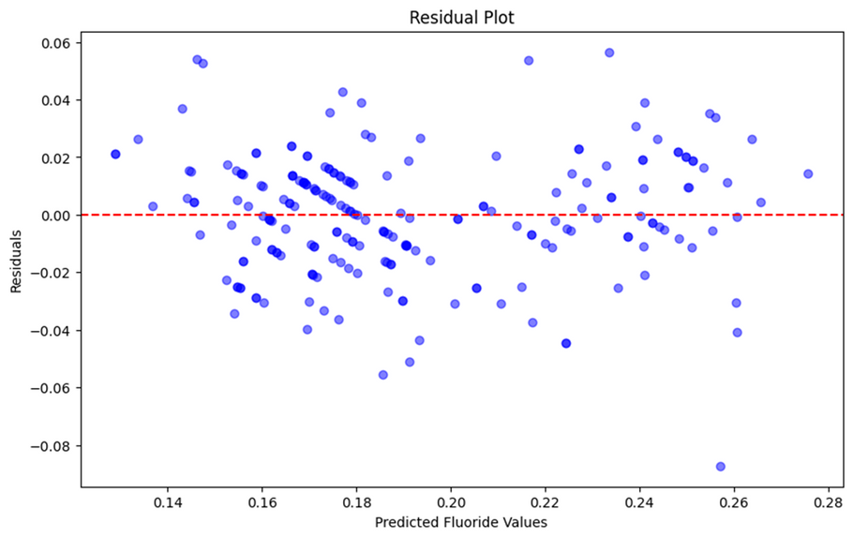
STEADY STATE MODELS
LINEAR REGRESSION

Slide 8
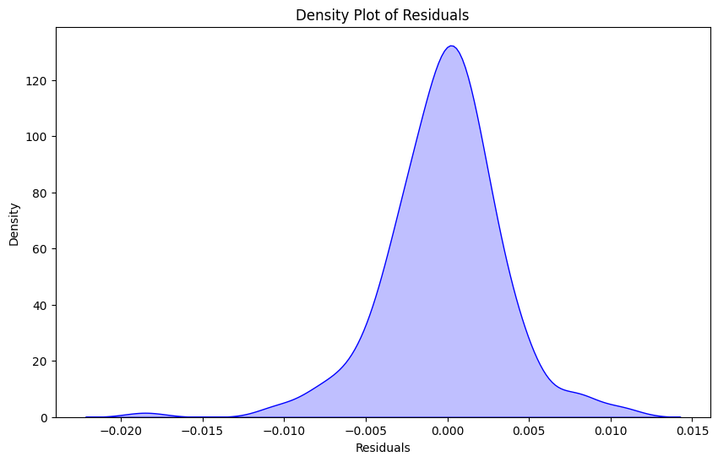
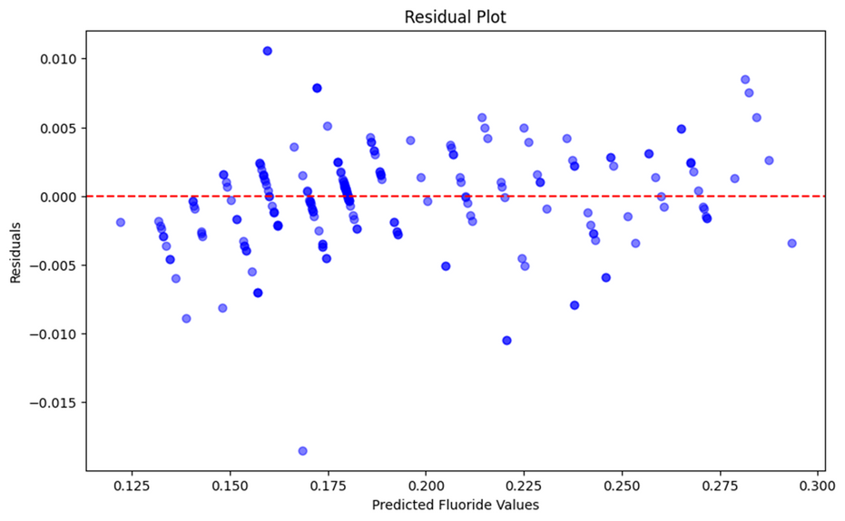
STEADY STATE MODELS
RANDOM FOREST REGRESSOR

Slide 9
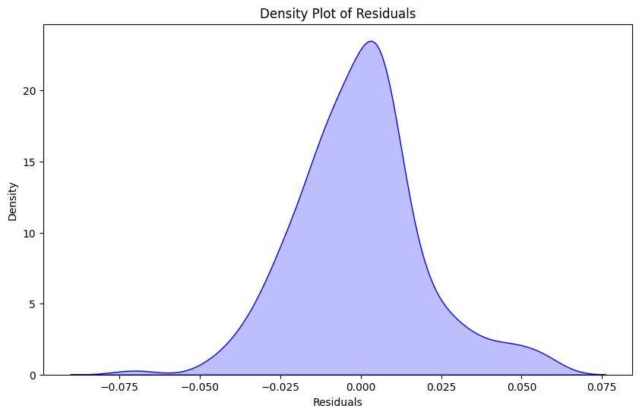
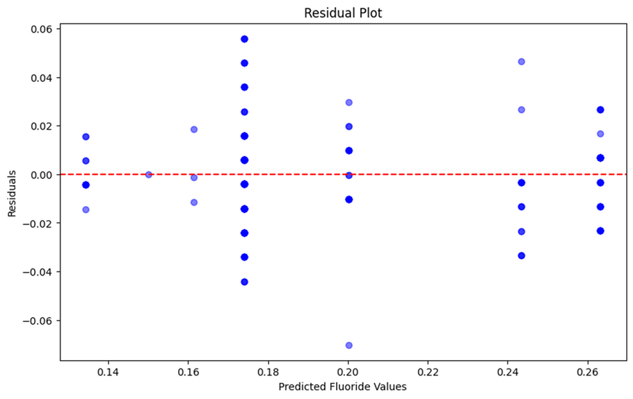
STEADY STATE MODELS
DECISION TREE REGRESSION MODEL

Slide 10
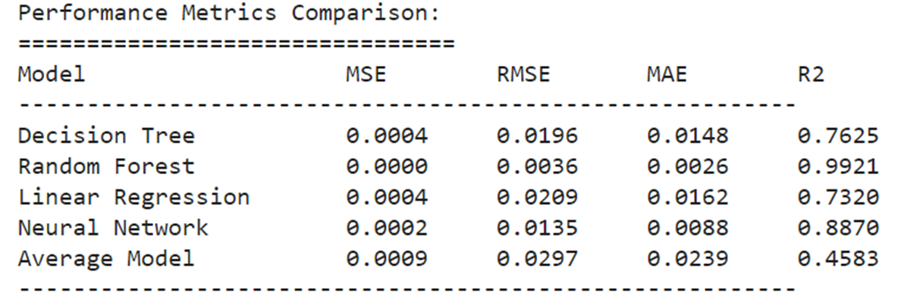
COMPARISON

Slide 11
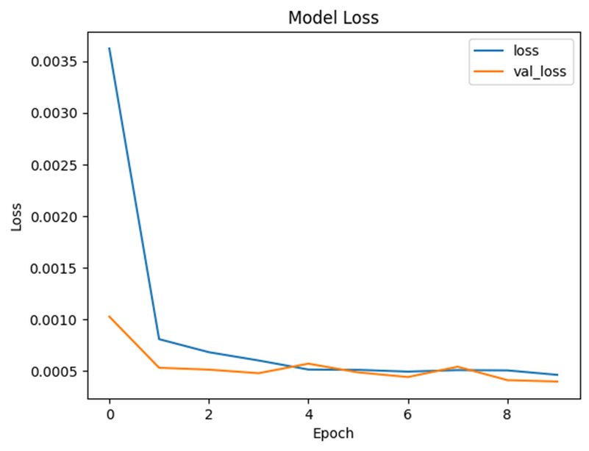
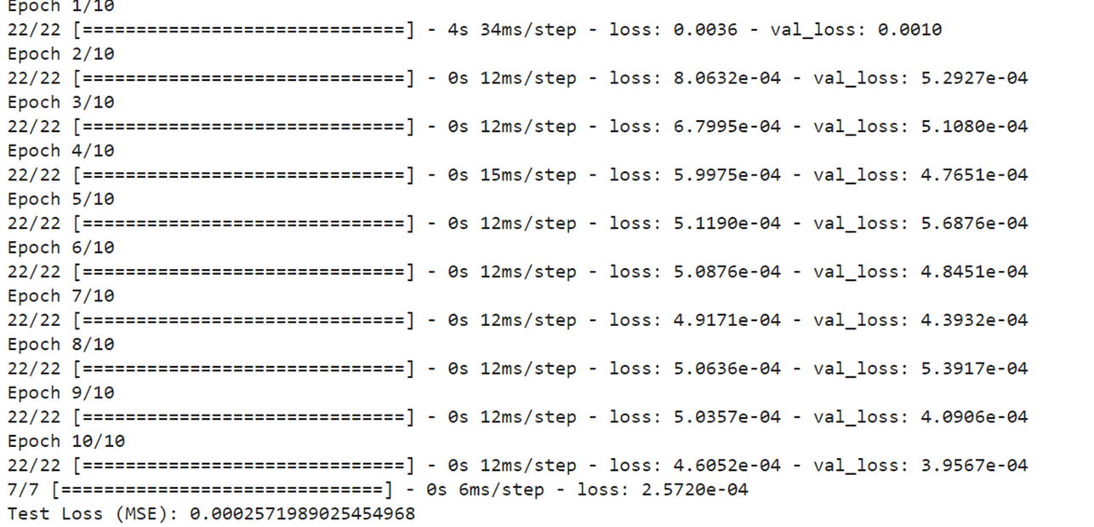
DYNAMIC MODELS
RECURRENT NEURAL NETWORK

Slide 12
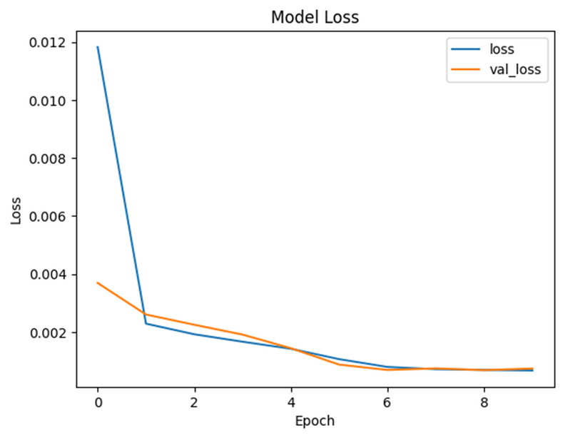
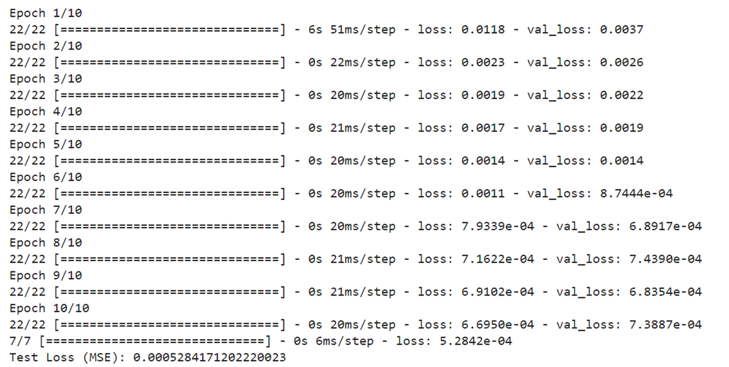
DYNAMIC MODELS
LONG SHORT-TERM MEMORY

Slide 13
CONCLUSION
The soft sensors used can overcome the drawbacks of high cost and long time needed in traditional measurement methods.
The learning accuracy of the models was compared, among which the predicted value of RNN is highly fit to the true value for the given dataset.
The reliability of the models used can be increased when the number and representativeness of the available samples increases.
The model algorithm with the best performance after screening is validated and calibrated by data to reflect the accuracy and robustness of the model prediction

Slide 14
Reference:https://home.isr.uc.pt/~fasouza/jpc2013_FranciscoSouza.pdf
THANK YOU

